Slide 1
Assessment Strategy Overview School of Biosystems & Food Engineering
Assessment Integrity in the Era of Large Language Models: Threats and Opportunities within the UCD College of Engineering & Architecture
June 2023

Slide 2
100,000
513
116,849
modules offered by the
College of Engineering & Architecture in 2022/23
student credits taught* by the
College of Engineering & Architecture in 2022/23
64
7,845
modules offered by the
School of Biosystems & Food Engineering
in 2022/23
student credits taught* by the
School of Biosystems & Food Engineering
in 2022/23
39
Level 4
0
Level 5
School of Biosystems & Food Engineering
number of modules by level
1
Level 1
5
Level 2
19
Level 3
47
5-credit modules offered within the School
12
10-credit modules offered within the School
5
15+-credit modules offered within the School
175
different assessed components within modules offered by the School of Biosystems & Food Engineering
in 2022/23
Assignment
most common assessment type used within modules
offered by the School of Biosystems & Food Engineering
in 2022/23
Essay
least common assessment type used within modules
offered by the School of Biosystems & Food Engineering
in 2022/23
*Student Credits Taught = Module ECTS Credits × 2022/23 Enrolled Students

Slide 3
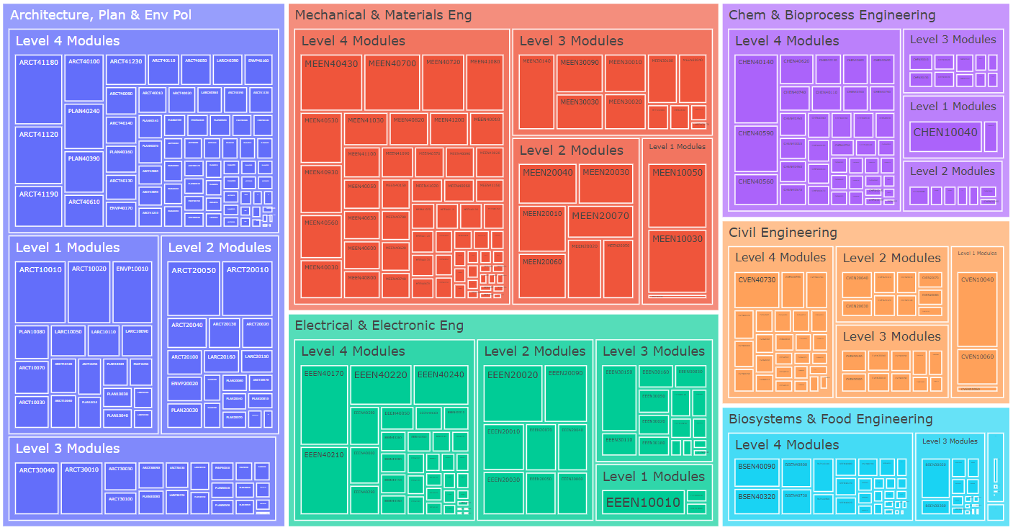
College of Engineering & Architecture – Modules by School
2022/23 Academic Year – Modules Weighted by Student Credits

Slide 4
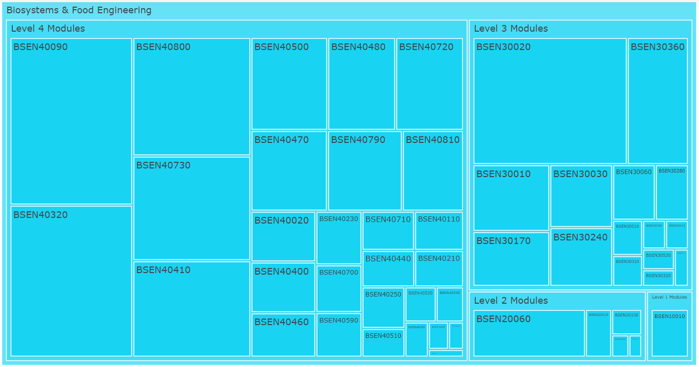
School of Biosystems & Food Engineering Modules
2022/23 Academic Year – Modules Weighted by Student Credits

Slide 5
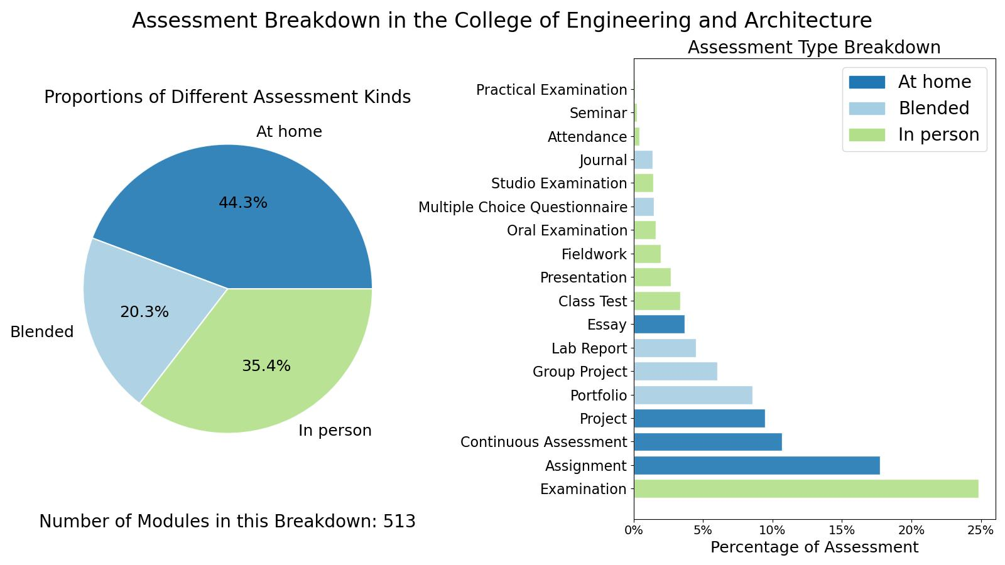
College of Engineering & Architecture

Slide 6
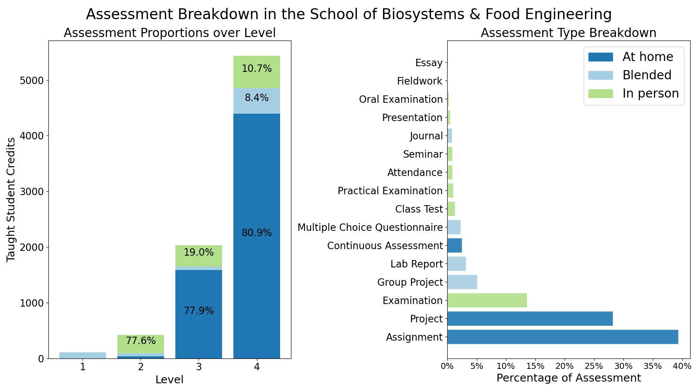
School of Biosystems & Food Engineering

Slide 7
Assessment Strategy Overview School of Biosystems & Food Engineering Assessment Integrity in the Era of Large Language Models: Threats and Opportunities within the UCD College of Engineering & Architecture June 2023

